Slide 1
SEC285 Module 3 Stateful Firewall

Slide 2
Rubric
Activity | Requirement(s) | Points
Question | Answer | 30
Nmap Scan | Screenshot | 30

Slide 3
Question
What effect does the sudo iptables --policy INPUT DROP command have on the access to computing resources?
Answer here:
The iptables -P INPUT DROP is known to be an -P switch that places the default policy on any given chain.
References: google
Virtual machine
nannija

Slide 4
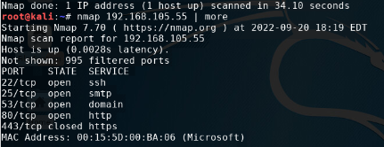
Nmap Scan
This screenshot should show the Nmap scan result of the Linux Server VM.

